Slide 1

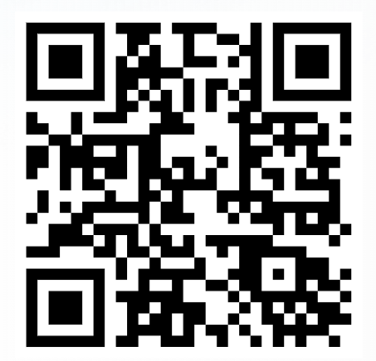
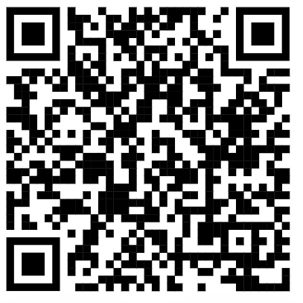
Tips For Wellness
Mental Health in Schools Team
Relaxation
Relaxation is when our mind and body is free from stress and tension. Research has found that this can help us to think clearly, concentrate, sleep well, feel more confident and even boost our immune system!
Relaxation can look different for everyone, and it can be helpful to try a few different relaxation techniques to see what works best to make you feel happy and rested.
Our Tips for Relaxation:
1- Try some breathing exercises, such as finger breathing or square
breathing. Breathing exercises are great as you can do them in any place,
at any time. Follow the QR code to try rainbow breathing!
2- Drawing or colouring can help you to express your feelings and focus on something peaceful. This is a great way to relax your mind!
3- Practice mindfulness by taking a break away from any screens and devices. This could be going on a walk or being outside in nature. Try to use as many of your senses as possible, think about what you can see, hear, smell, touch and even taste! You could even try cloud watching to calm your mind.
4- Stretch it out, practice yoga to stretch out your muscles to relax and
reduce tension. Try following the QR code for a yoga video!
5- A warm bath or shower can be a soothing experience that helps to relax muscles and calm your mind. You could make it extra relaxing with quiet music and bubbles!
Rainbow breathing
Calming yoga stretches
In Coventry and Warwickshire, for any urgent mental health concerns, contact the RISE Crisis Helpline available 24/7, by calling NHS 111. Alternatively, call 999 or visit A&E in an emergency, for example if medical attention is required.
MHST are available to support you and your school throughout the school year including term time and school holidays.
Please contact your school's Mental Health Lead for information and advice.

